Slide 1
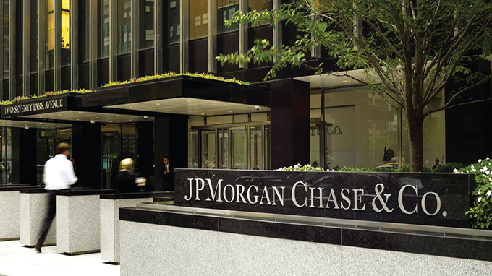
DAB 401 Financial Analytics
GROUP 2
Akshar Patel (0793127)
Hiren Patel (0797548)
Jigar Patel (0794004)
Kush Patel (0792972)

Slide 2


Slide 3
INTRODUCTION
History of JP Morgan:
JP Morgan Chase is one of the largest banking institutions in the world.
It was founded in 1799 by Aaron Burr, who was then Vice President of the United States.
The bank initially operated as The Manhattan Company, established to provide clean water to New Yorkers.
In 1823, The Manhattan Company merged with another bank to form the Merchant's Bank.
The Merchant's Bank later became known as the National City Bank of New York.
The bank continued to grow in size and influence, becoming one of the most powerful financial institutions in the world.

Slide 4
INTRODUCTION
History of JP Morgan Cont.:
In 1871, John Pierpont Morgan took control of the banking firm Drexel, Morgan & Co.
He renamed it JP Morgan & Co. and began expanding the company's reach and influence.
Morgan was instrumental in financing many of America's largest corporations, including General Electric and US Steel.
He played a key role in stabilizing the country's financial system during times of crisis such as the Panic of 1907.

Slide 5
INTRODUCTION Cont.
Industry Environment and Competitors:
JP Morgan operates in a highly competitive industry, with many other financial services firms vying for market share.
Some of the top competitors of JP Morgan(almost 18%) include Bank of America (Bank of America had a 10.7% market share in the US banking industry as of Q4 2021), Wells Fargo (Wells Fargo had a 6.6% market share in the US banking industry as of Q4 2021), and Citigroup (Citigroup had a 4.1% market share in the US banking business as of the fourth quarter of 2021). These organizations offer similar financial services and compete aggressively for customers.
Despite the intense competition, JP Morgan has maintained a strong position in the market. The organization is currently the largest bank in the United States by assets, and it has a significant presence in key financial markets around the world.

Slide 6
RATIO AND VALUATION ANALYSIS
Ratio Analysis
Ratio Analysis is a quantitative method of gaining insight into a organization’s liquidity, operational efficiency, and profitability by studying its financial statements.
Ratio Analysis helps in determining how efficiently a organization is operating. It provides significant detail of accounting information regarding the performance of the business.

Slide 7
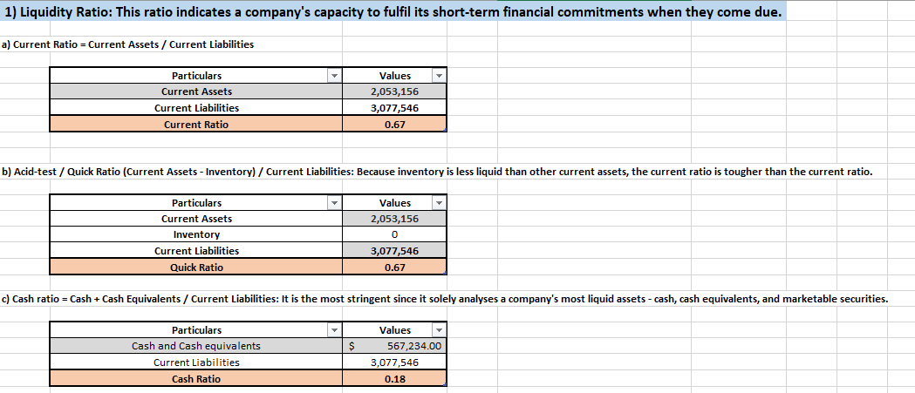
RATIO AND VALUATION ANALYSIS
Ratio Analysis
1) Liquidity Ratios:
Liquidity ratios are financial ratios that measure an organization’s ability to meet its short-term financial obligations.

Slide 8
RATIO AND VALUATION ANALYSIS
Current Ratio (0.67): An organization has 0.67 times more current assets than current liabilities, including good short-term solvency.
Quick Ratio (0.67): An organization can cover its short-term liabilities using its quick assets, with some room for additional liquidity.
Cash Ratio (0.18): An organization has less cash and cash equivalents to cover its short-term obligations, indicating lower liquidity.

Slide 9
RATIO AND VALUATION ANALYSIS
2) Profitability Ratios:
It is a financial ratio that measure an organization’s ability to generate profits from its operations.

Slide 10
RATIO AND VALUATION ANALYSIS
2) Profitability Ratios Cont.:
Gross Profit Margin (57.90%): JP Morgan earns 57.90 percents of gross profit for every dollar of revenue. Indicating good profitability.
Return on Assets (1.03%): An organization earns 1.03 cents of profit for every dollar of assets invested. Indicating neither inherently good nor bad asset utilization.
Return on Equity Ratio (12.89%): An organization generates 12.89 cents of profit or every dollar of shareholder equity , indicating healthy level of return.
Net Profit Margin (29.28%) - The organization earns 29.28 cents of net profit for every dollar of revenue, indicating a moderate profitability after expenses.

Slide 11
RATIO AND VALUATION ANALYSIS
2) Profitability Ratios Cont.:
Operating Profit Margin (56.15%) - The organization earns 56.15 cents of operating profit for every dollar of revenue, indicating a moderate profitability from operations.
Earnings per Share (9.18) - The organization earns 9.18 cents of operating profit for every $1 of revenue, indicating a moderate profitability from operations.

Slide 12
RATIO AND VALUATION ANALYSIS
3) Other Ratios:
Price/Earnings Ratio (15.39): The market values the organization’s stock at 15.39 times its earning’s per share.
Dividend Payout Ratio (0.01%): An organization pays out 0.01 cents of dividends for every dollar of earnings.
Debt to equity Ratio (1.60): The organization has 1.60 cents of debt for every dollar of shareholder equity.
Sustainable growth Rate (3.37%): organization’s overall sustainable growth is 3.37% over the past five years.

Slide 13
RATIO AND VALUATION ANALYSIS
Over the past five years, JP Morgan, a leading financial services firm with a long and storied history, has consistently experienced a continuous increase in total revenue. From 2018 to 2022, the total revenue has risen steadily, reaching $128,695 million in 2022 from $109,029 million in 2018. This upward trend in revenue showcases JP Morgan's strong financial performance and market position, indicating its ability to effectively navigate challenges in the macroeconomic and industry environments while capitalizing on opportunities. It highlights the organization's resilience and strategic approach to driving revenue growth, which serves as a positive indicator of its financial strength and stability in the competitive global financial industry.

Slide 14
RATIO AND VALUATION ANALYSIS
CAPITAL ASSET PRICING MODEL(CAPM):
CAPM is a financial model that calculates the expected rate of return for an asset or investment.
CAPM calculates the returns by using the expected return on both the market and a risk-free asset, and the asset’s correlation or sensitivity to the market.
The risk-free return refers to the rate of return an investor expects to earn from a risk-free investment.
Beta (β) - Volatility in relation to the overall market. Beta is an estimation of volatility, and there is always some error associated with any estimation method.

Slide 15
RATIO AND VALUATION ANALYSIS
CAPITAL ASSET PRICING MODEL(CAPM):
Ra​=Rf​+β(Rm​−Rf​)
where:
Ra​=expected return of investment
Rm =6.92%
Rf​=3.61% (Treasury Yield 5 Years)
β​=1.10(April 12, 2023)
= 3.61% + 1.10*(6.92%-3.61%)= 7.25%
Expected return of the investment, on the JP Morgan stocks, is 7.25% per year.
https://finance.yahoo.com/quote/%5EFVX?p=%5EFVX
https://finance.yahoo.com/quote/JPM?p=JPM

Slide 16
RATIO AND VALUATION ANALYSIS
Dividend Growth Model:
Our dividend growth rate is constant.(0.5 to 1.0 between 2018-2022)
https://finance.yahoo.com/quote/JPM/history?period1=1514764800&period2=1672444800&interval=capitalGain%7Cdiv%7Csplit&filter=div&frequency=1mo&includeAdjustedClose=true

Slide 17
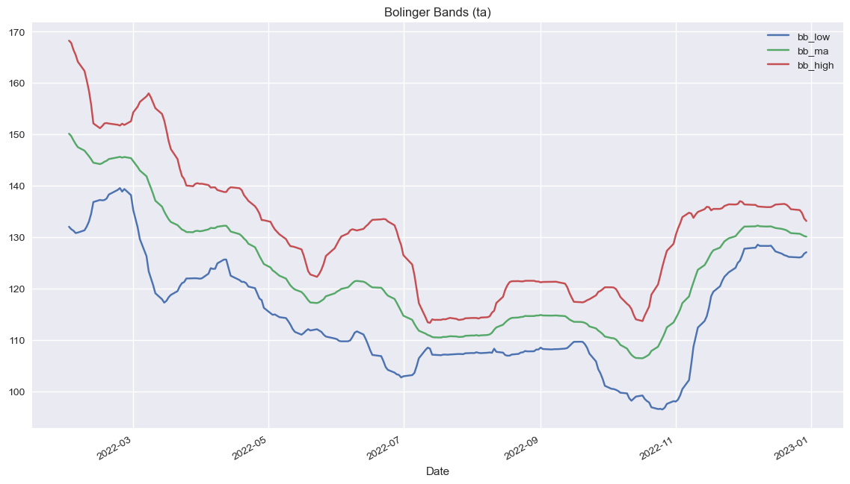
Technical Analysis
Bollinger Band:
All three bands are trending upward, it may suggest a strong bullish market condition where the price is consistently moving higher, and there is potential for further price gains.

Slide 18
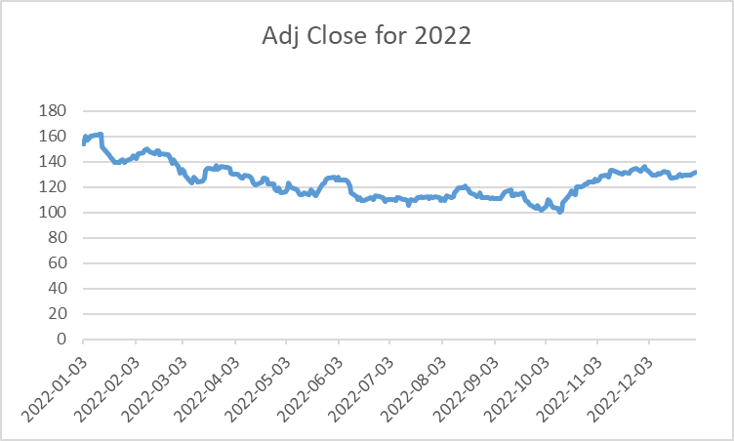
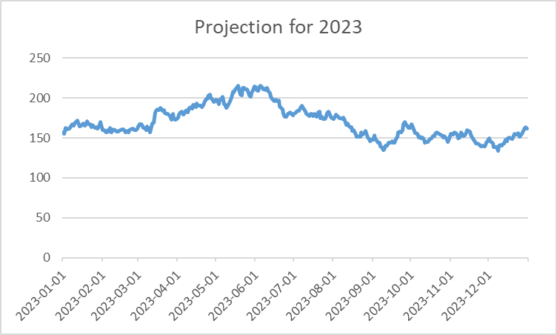
Technical Analysis
Monte Carlo Simulation:
​Developed a Monte Carlo simulation (MCS) model to forecast the stock price for 12 months(Jan 1, 2023, to Dec 31, 2023)
Conducted 10,000 simulations to generate a range of possible future outcomes for the stock price.

Slide 19
Technical Analysis
Monte Carlo Simulation:
Based on the projection for 2023, it is evident that the price is expected to increase after some fluctuations.

Slide 20
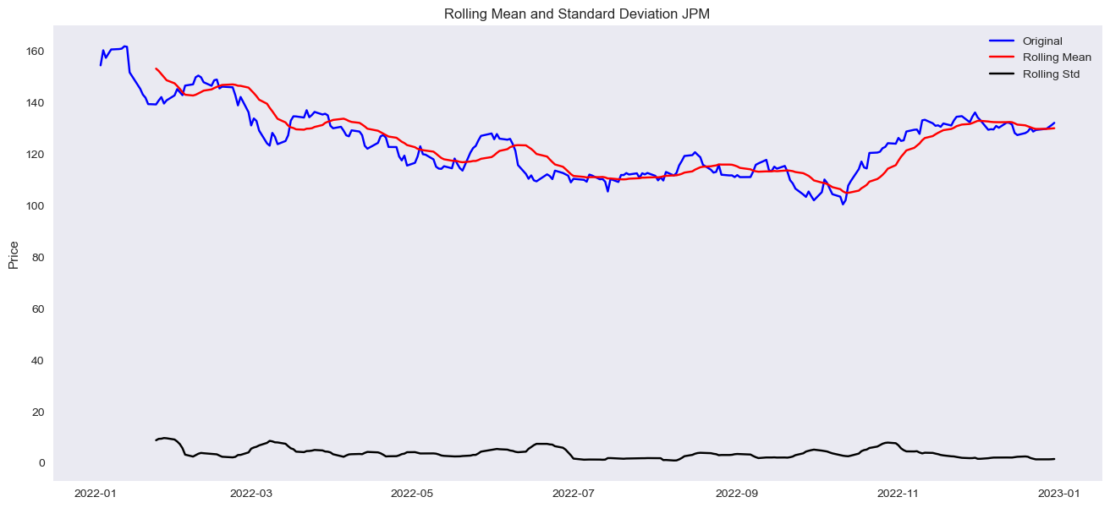
Technical Analysis
Simple Moving Average:

Slide 21
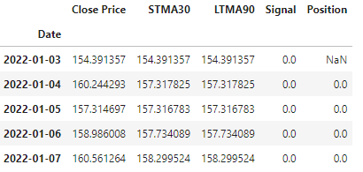
Technical Analysis
Simple Moving Average:
The stock price of the organization was relatively stable between January 3 to January 7, 2022, with a slight increase on January 4.
The short-term moving average and long-term moving average values for each day were almost the same, indicating that the stock price did not deviate much from its averages during this period.
However, this short-term snapshot alone may not be enough to provide a comprehensive understanding of the stock's performance. Further analysis is required to make informed investment decisions.

Slide 22
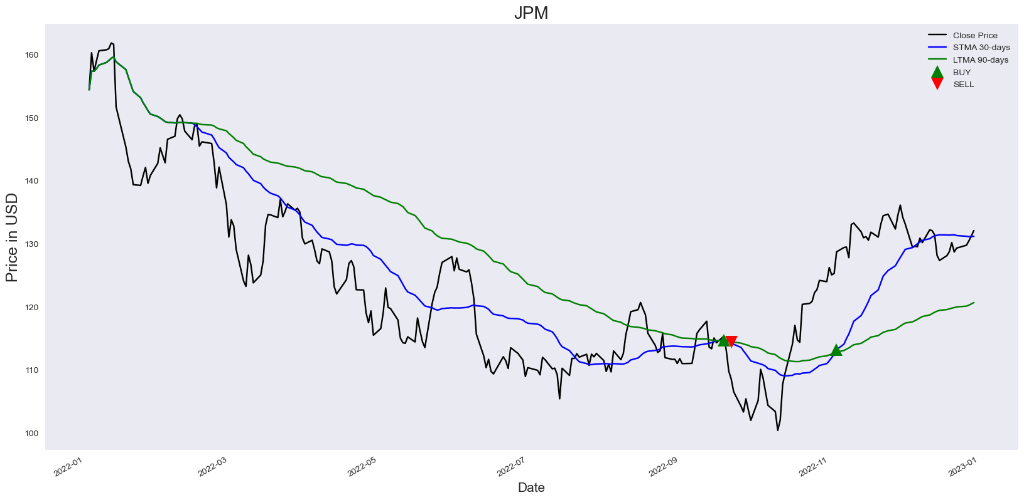
Technical Analysis
Simple Moving Average:

Slide 23
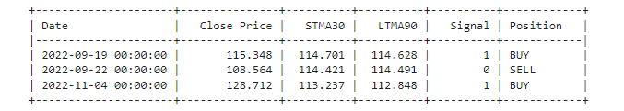
Technical Analysis
Simple Moving Average:
The information provided is about a trading strategy that uses short-term and long-term moving averages to generate buy and sell signals for JPM stock.
The strategy opened a buy position on September 19, 2022, but closed it on September 22, 2022, resulting in a loss. The strategy then opened another buy position on November 4, 2022.
It's important to note that relying solely on technical indicators may not always be a reliable approach, and other factors should also be considered before making investment decisions.

Slide 24
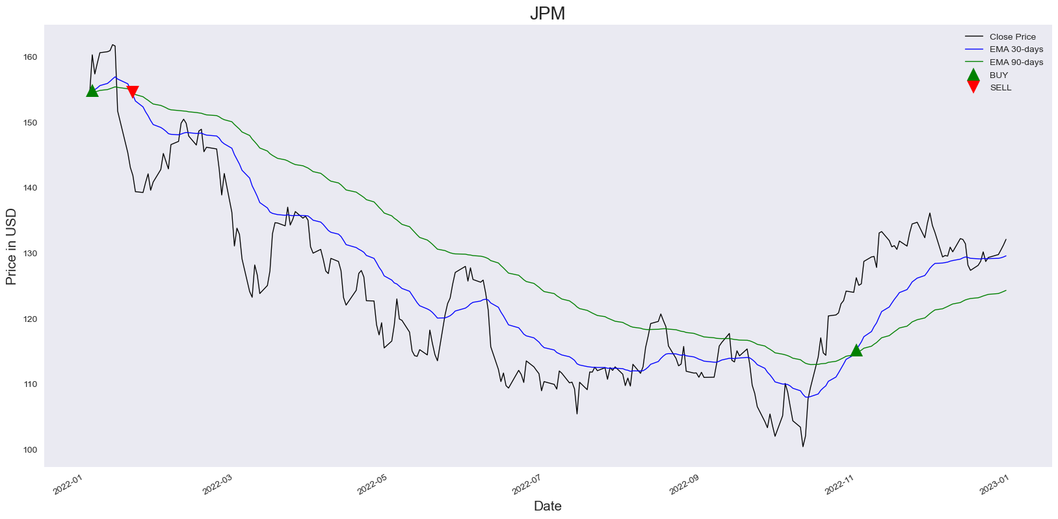
Technical Analysis
Exponential Moving Average:

Slide 25
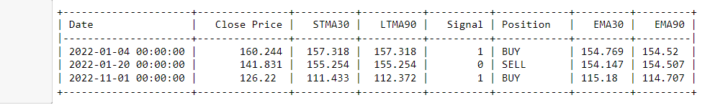
Technical Analysis
Exponential Moving Average:
The information provided is about a trading strategy that uses short-term and long-term exponential moving averages to generate buy and sell signals for JPM stock.
The strategy opened a buy position on January 04, 2022, but closed it on January 20, 2022, resulting in a loss. The strategy then opened another buy position on November 1, 2022.

Slide 26
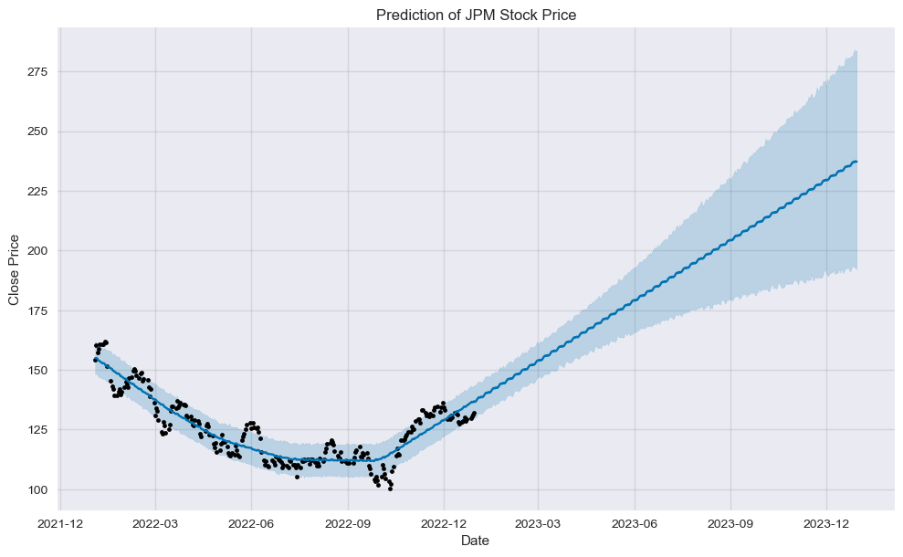
Technical Analysis
Forecasting using Facebook Prophet:
It is designed to process the forecasting of a time series data, which is data recorded over time, such as stock prices etc.
The model uses the historical data of JPM stock prices from January 1st, 2022, to December 31st,2022.
To make predictions for the next 365 days using the Prophet library.

Slide 27
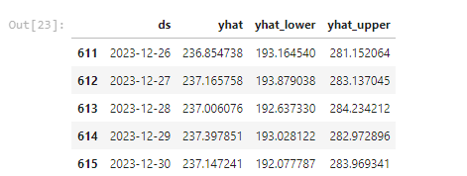
Technical Analysis
Forecasting using Facebook Prophet:
The forecast provides a prediction for the variable being forecasted (yhat) along with the lower and upper bounds of the forecast (yhat_lower and yhatupper) for the dates ranging from December 26, 2023 to December 30, 2023.
It seems that the forecast is predicting an increase in the value of the variable being forecasted over the given time period. The lower and upper bounds can be used to estimate the level of uncertainty associated with the forecast.
Based on this data, the model predicts that JP Morgan's stock price have slight frequent changes in value throughout December 2023, with a predicted price
on December 26th, 236.85,
on December 27th, 237.16,
on December 28th, 237.00,
on December 29th, 237.39,
on December 30th, 237.14
However, it's important to note that stock prices can be highly volatile and subject to many external factors, so these predictions may not necessarily be accurate.

Slide 28
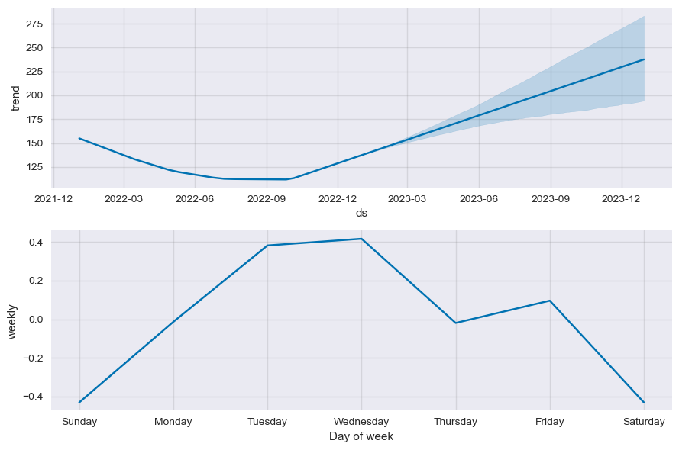
Technical Analysis
Forecasting using Facebook Prophet:
Based on the forecasting results, it can be inferred that the stock price is expected to exhibit an upward trend over the course of December 2023.
Based on the analysis, the data suggests a trend of price increase during weekdays, while a decrease in price during weekends.

Slide 29
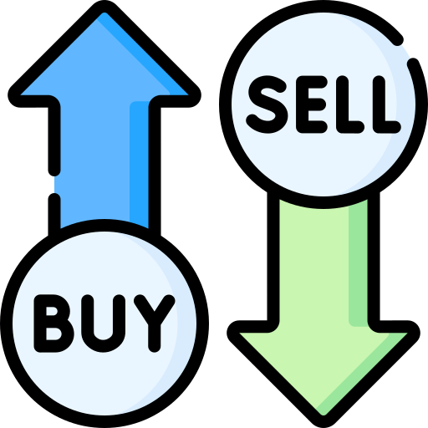
Recommendation
Current stock price of JP Morgan on April 19th, 2023: $141.22 USD.
Forecasted increase of more than $200 USD in 2023.
Advisable to consider purchasing the stock at its current lower price and hold onto it for future.
Expected to reach a higher price rate by the end of 2023, specifically on December 30th, 2023.
Forecasted value on December 30th, 2023: $237.14 USD.

Slide 30
Conclusion
JP Morgan is a leading financial services firm with a long and storied history.
The organization has played a significant role in many important events in American history.
Despite facing significant challenges in the current macroeconomic and industry environments, JP Morgan has maintained a strong position in the market.
The organization's focus on technology, sustainability, and social responsibility are key factors in its continued success in the years ahead.
Based on JP Morgan's strong market position and positive forecasted price, the stock may present a favorable investment opportunity.

Slide 31
References
https://finance.yahoo.com/quote/JPM/
https://www.macrotrends.net/stocks/charts/JPM/
https://www.vectorstock.com/royalty-free-vectors/stock-market-logos-vectors
https://www.youtube.com/watch?v=5jjdErDkDZE&pp=ygUTaGlzdG9yeSBvZiBqcG1vcmdhbg%3D%3D
https://finance.yahoo.com/quote/%5EFVX?p=%5EFVX
https://www.flaticon.com/free-icon/

Slide 32

THANK YOU !!

